Slide 2
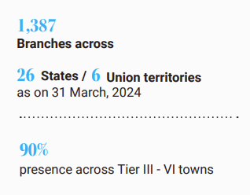
Our Geographical Presence
Jammu & Kashmir (7)
Punjab (28)
Himachal Pradesh (17)
Chandigarh (1)
Haryana (41)
Uttarakhand (20)
Delhi (6)
Sikkim (2)
Arunachal Pradesh (1)
Rajasthan (101)
UP (91)
Assam (36)
Bihar (55)
Meghalaya (4)
Gujarat (74)
Mizoram (1)
Madhya Pradesh
(94)
Tripura (6)
Dadra & Nagar Haveli (1)
Jharkhand (34)
West Bengal (67)
Maharashtra (151)
Goa (3)
Chhattisgarh (75)
Odisha (59)
Telangana (50)
Karnataka (84)
Andhra Pradesh (63)
Andaman & Nicobar (1)
Puducherry (2)
Kerala (55)
Tamil Nadu (157)
1

Slide 3
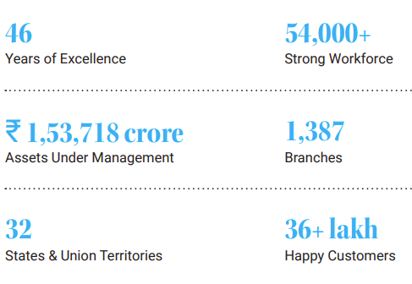
Our Key Strengths
Our Business Verticals
Vehicle Finance
Home
Loans
Secured Business & Personal Loan
Loan Against Property
Consumer & Small Enterprise
Loan
SME Loans
2

Slide 4
Highlights – FY 24
Disbursements
Total Assets Under Management
Total AUM grew over Rs.1.53 Lakh Crore in FY 24 with a growth of 36%
Profit After Tax
Consistently delivering a PAT growth of over 20% in the last 10 years, FY 24 PAT growth was at 28%
Consistently delivering ROE of over 15% in the last 10 years, FY 24 ROE was at 20.6%
Return On Equity
Chola launched a composite QIP issue of equity shares for ₹ 2,000 Cr and Compulsorily Convertible Debentures of ₹2,000 Cr overall aggregating to ₹ 4,000 Cr. Capital Adequacy stood at 18.57% with Tier I Capital at 15.10% as on Mar-24
Asset Quality
Number of Customers
Increased customer base to 36+ lakhs in FY 24 from 25+ lakhs in FY 23
Equity Infusion and Capital Adequacy
Strong collections resulted in improved Asset quality with Gross Stage 3 improving to 2.48% in FY 24 from 3.01% in FY 23
Highest ever Disbursements at over Rs.88,725 Cr with growth across all major Product Segments
3

Slide 5
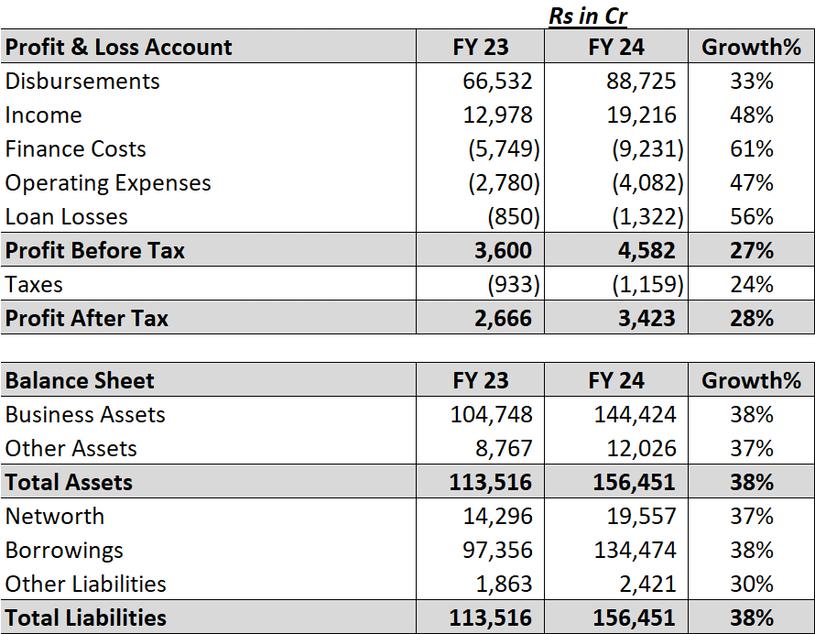
Standalone Financials
4

Slide 6
Financial Results
Q1 FY 25
5

Slide 7
Standalone Financials
6

